Slide 1

Can we chat with the future energy? Deciphering Energy Scenarios
Energy Science Center
Adriana Marcucci, Jan Abrell and Sven Rüegg
11. September 2025
Energy Data Hackdays, FHNW

Slide 2

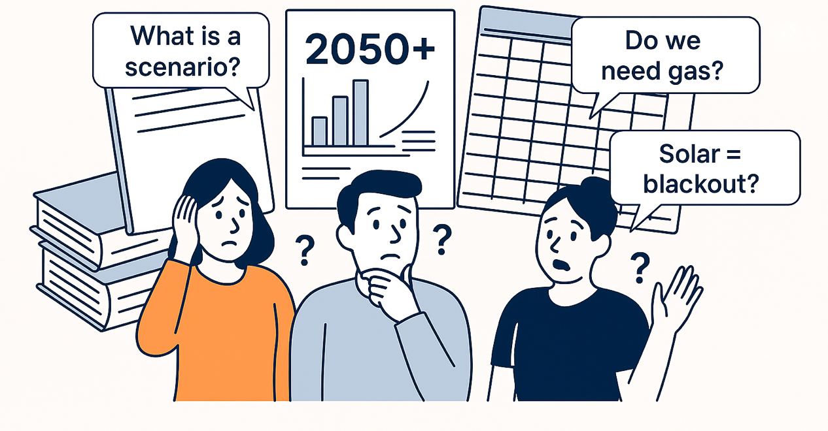
The problem: Energy scenarios are difficult to understand, difficult to access
Notes:
Dense PDFs, technical language, hidden in websites.

Slide 3
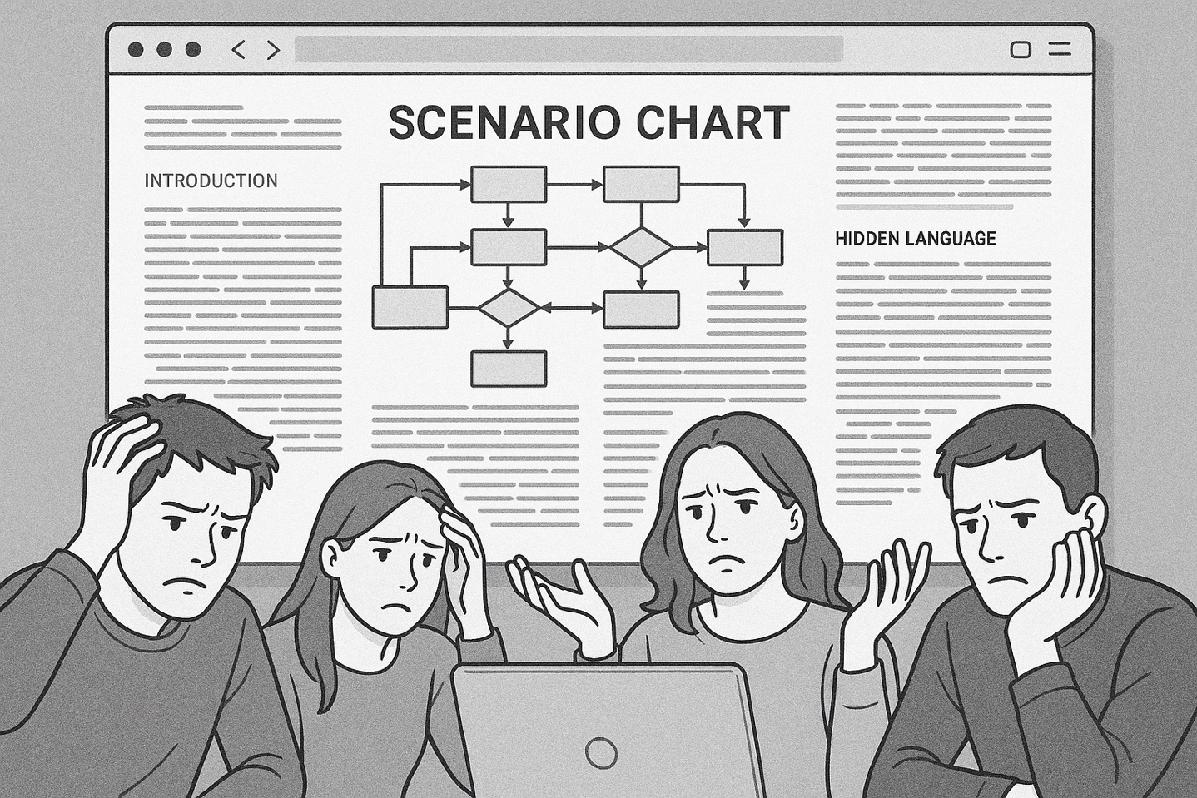
Why does it matter? Decisions need understanding
Citizens, journalists, students, even policymakers need quick answers.
Trust in energy transition grows when people grasp scenarios.
Today: only experts (or not even) can interpret energy scenarios
Notes:
Accessing and interpreting the BFE Energieperspektiven 2050+ scenarios is a daunting task for most citizens. The data is scattered across multiple formats, including PDFs, ZIP files, and interactive dashboards, which are not user-friendly. These resources require a high level of expertise and time commitment to navigate and understand. As a result, the valuable insights contained within these scenarios remain out of reach for the general public. This accessibility gap undermines the democratic process and limits the effectiveness of energy policy communication. Bridging this gap is essential to ensure that all stakeholders, including non-experts, can participate in discussions about Switzerland’s energy future. A chatbot can serve as a gateway to this information, providing instant, personalized, and understandable explanations.

Slide 4
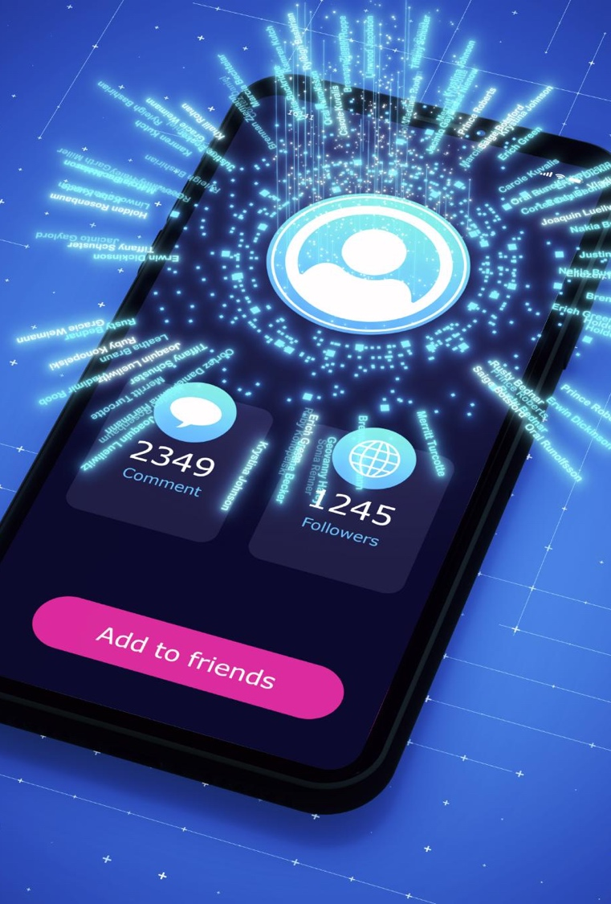
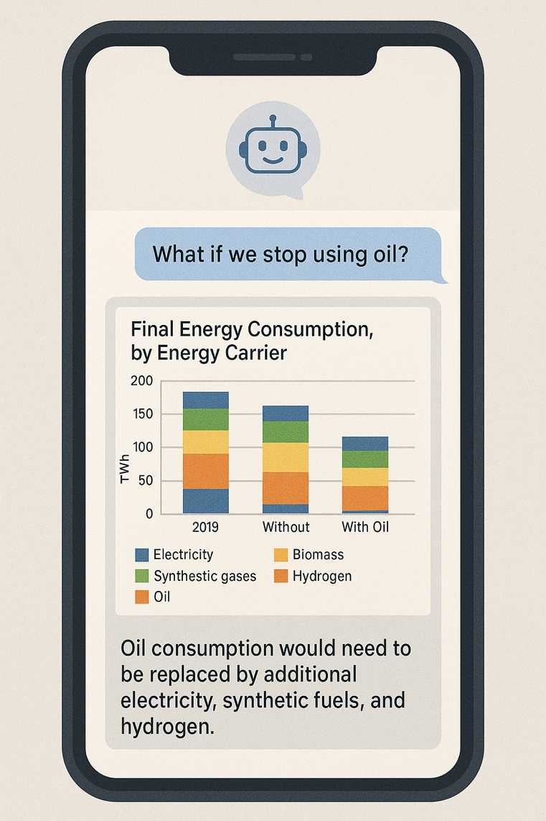
Our solution Chatbot for Energy Scenarios
Conversational access to scenarios.
Explain numbers in plain language.
Interactive, 24/7, accessible.

Slide 5



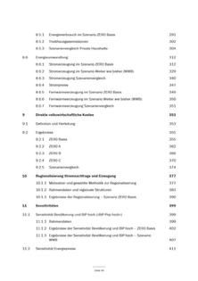

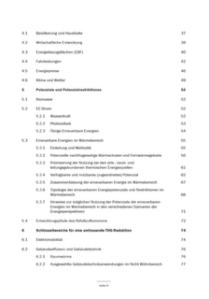
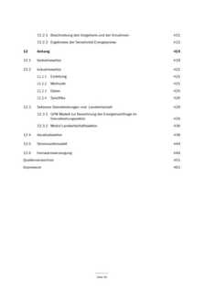
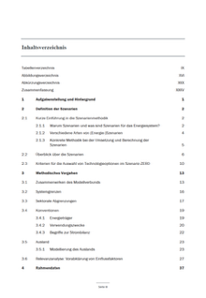
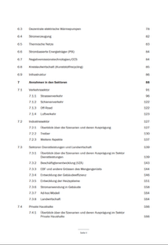
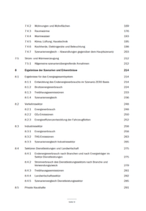
The task Can we chat with the energy future?
Build a chatbot that connects to a database of energy scenarios. Users type in natural questions, and your bot retrieves clear, meaningful answers.
Question
LLM
Build Query
Process data
LLM
Answer
Context
Query
Data
Context
Schemas
Database
Energie Perspektiven 2050+, BFE
Existing Reports

Slide 6
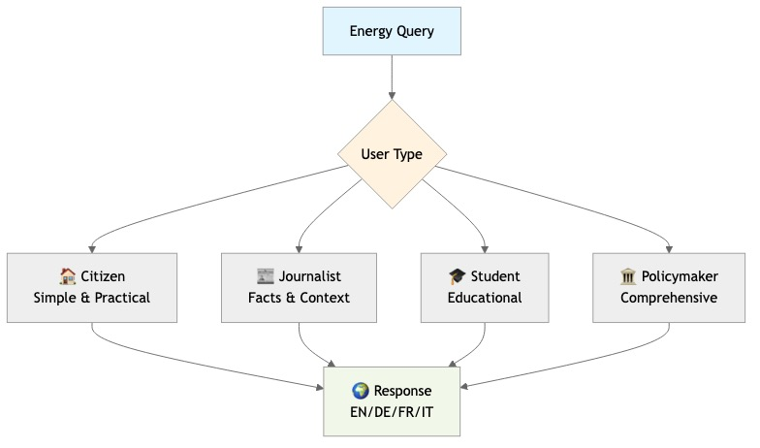
Personas
Many Personas.

Slide 7
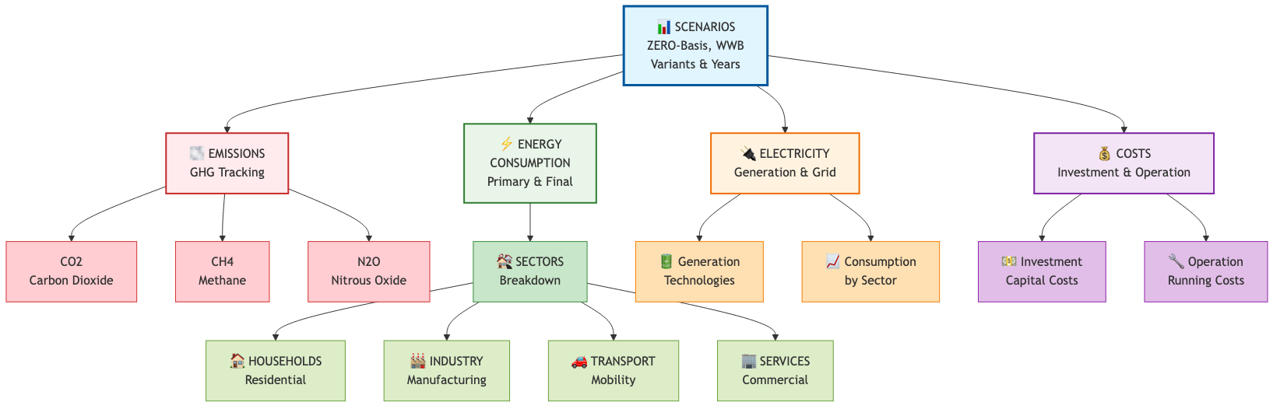
Scenarios
Scenario Composition.

Slide 8
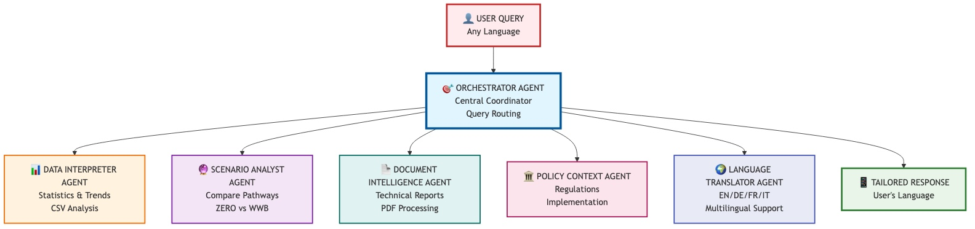
Agents
Scenario Composition.

Slide 9
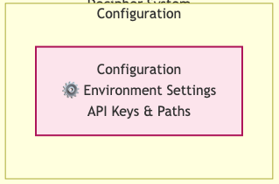
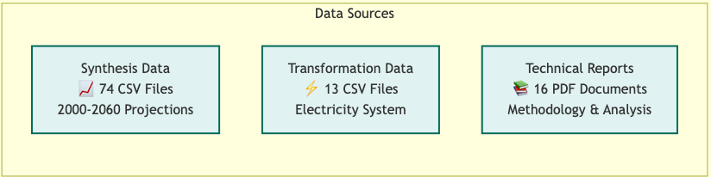
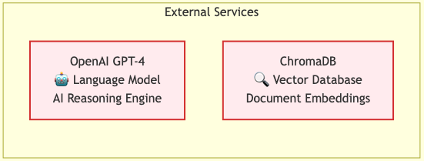
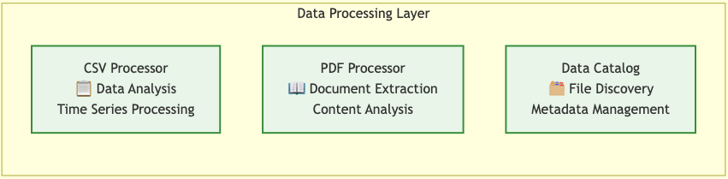
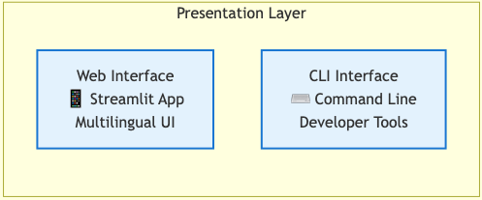
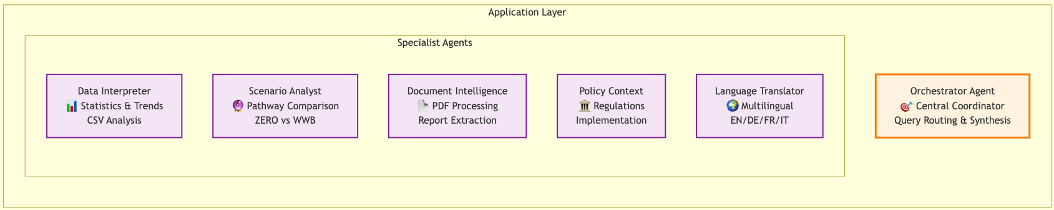
Component and Services

Slide 10
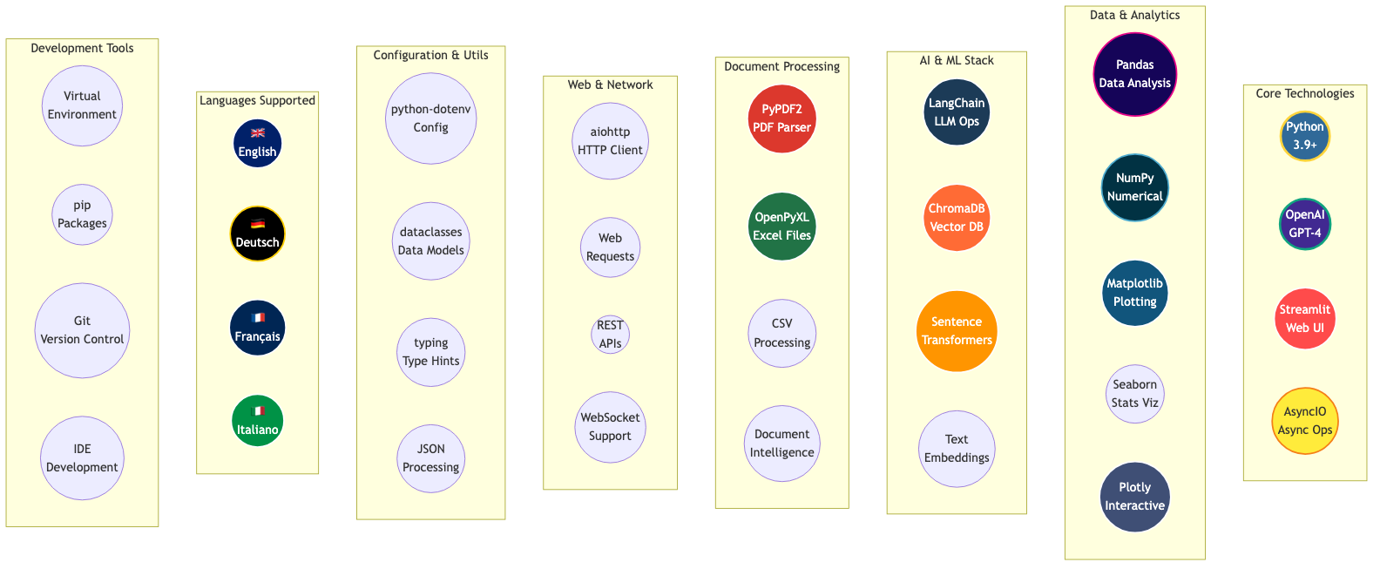
Agents
Scenario Composition.

Slide 11

Join our team and chat with the energy future
Developers, designers, data scientists, and energy enthusiasts to bridge technical content with public engagement

